Slide 1
Introduction
- Overview of lionfish species
- Habitat and distribution
[Visual/Image]

Slide 2
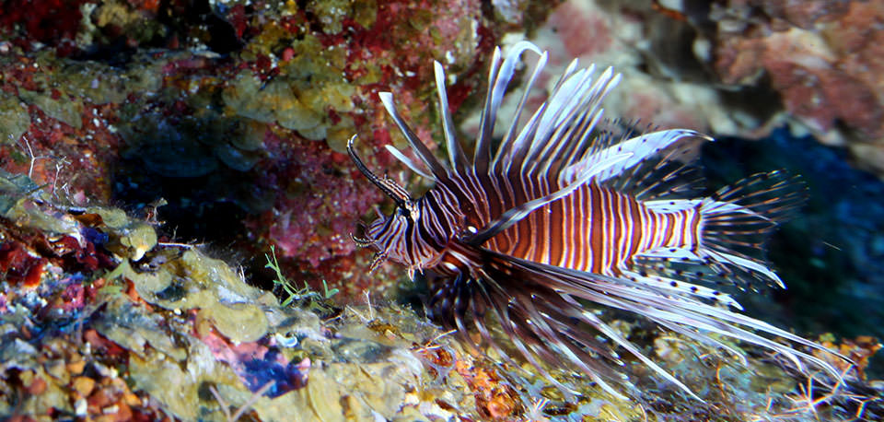
Physical Characteristics
- Distinctive spines and coloration
- Size and weight

Slide 3
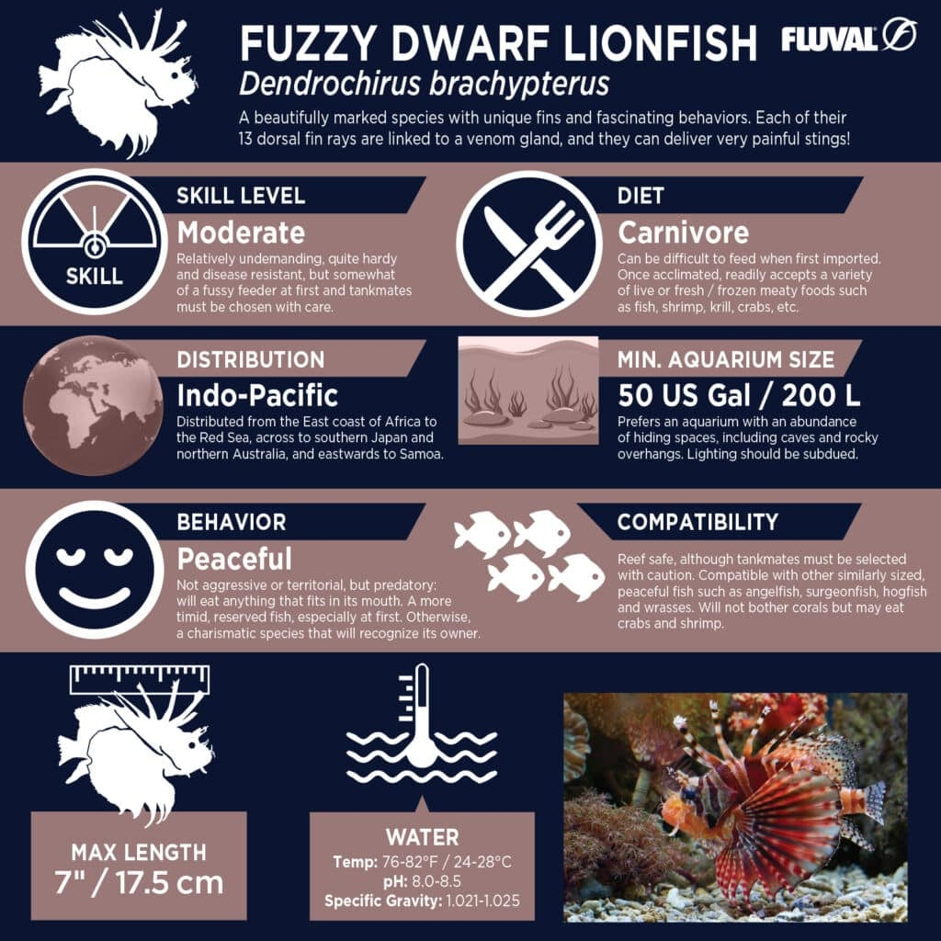
Behavior and Diet
- Predatory nature
- Diet: small fish and crustaceans

Slide 4
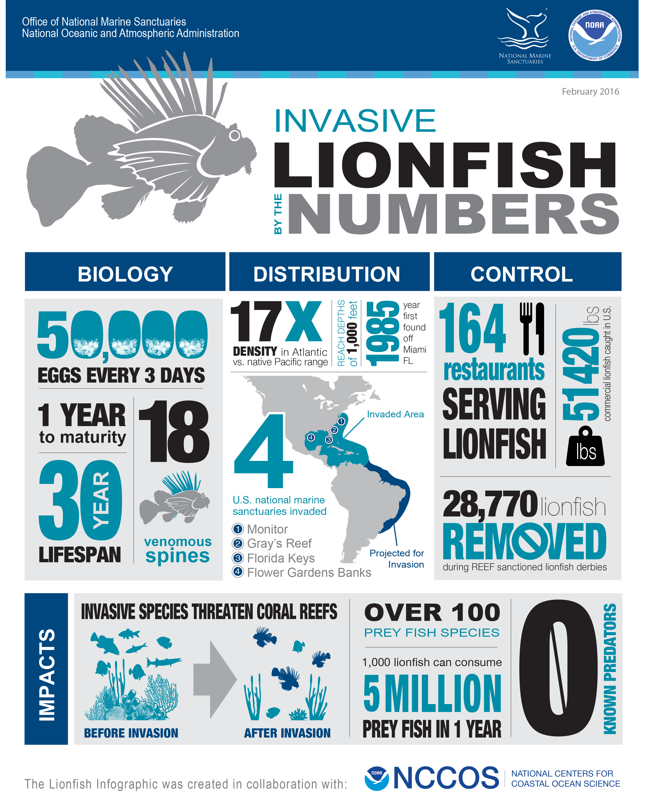
Ecological Impact
- Invasive species in the Atlantic
- Effects on local ecosystems

Slide 5
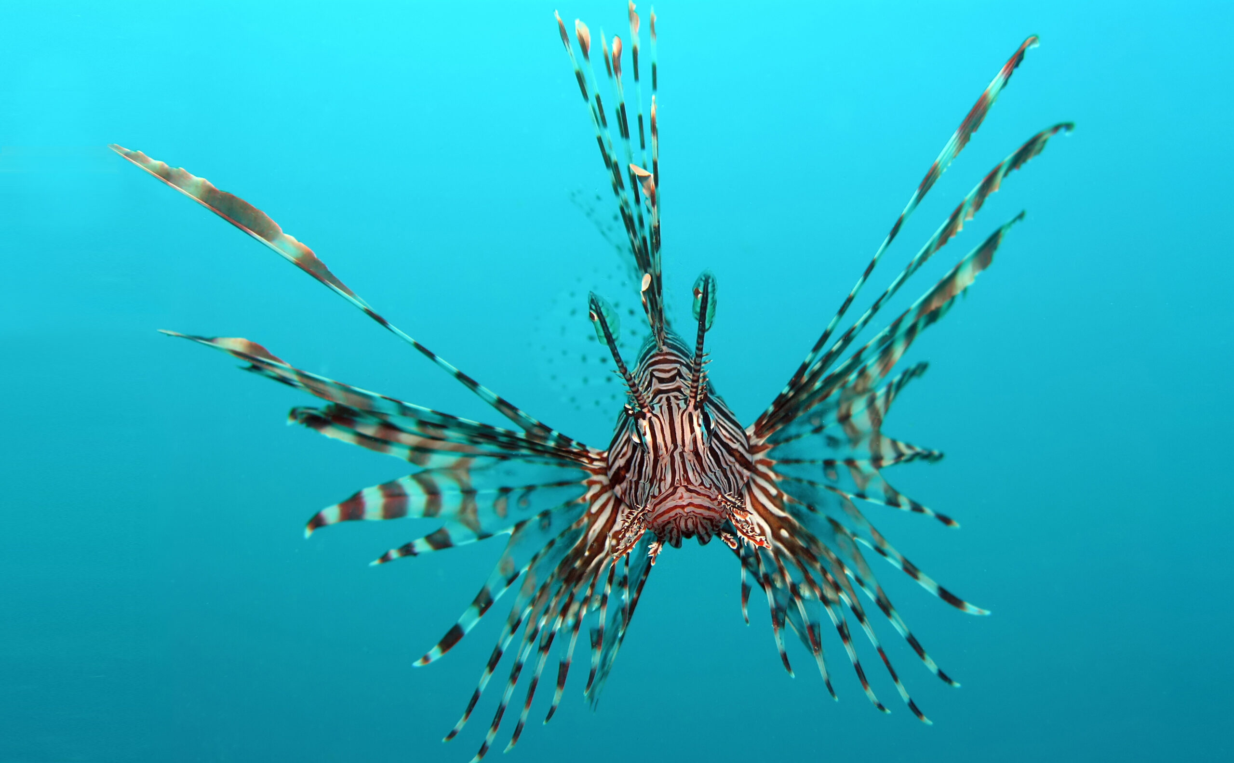
Management and Control
- Efforts to control lionfish populations
- Importance of public awareness

Slide 6
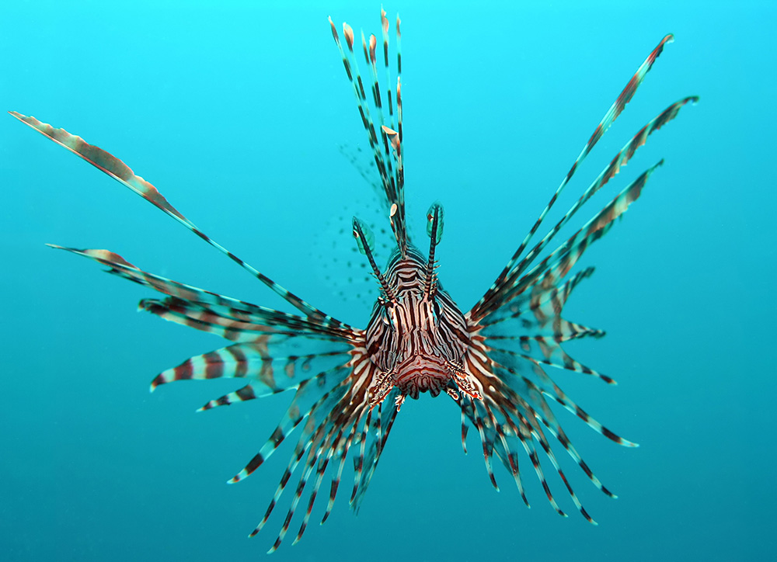
Conclusion
- Summary of key points
- Call to action for conservation efforts.

